Slide 1
Projects as part of the bigger picture
Business Intelligence & Analytics

Slide 2
BA Mantra
Think big, start small, and deliver fast

Slide 3
BA Mantra
Think big, start small, and deliver fast
Be ambitious

Slide 4
BA Mantra
Think big, start small, and deliver fast
Be ambitious
Break big idea into smaller chunks

Slide 5
BA Mantra
Think big, start small, and deliver fast
Be ambitious
Break big idea into smaller chunks
Make solid plans for what to deliver and when

Slide 6
Maturity models
Useful tools when planning projects
Help determine where you are and where you want to be
Place individual systems in a broader context
Describe the business opportunities each opens
Revolutionary vs evolutionary developments

Slide 7
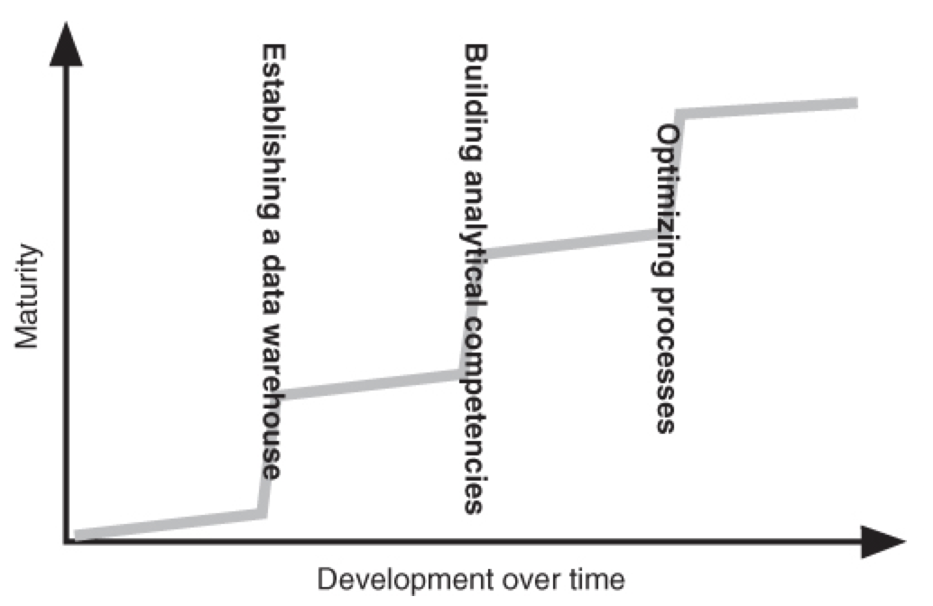
Generic maturity model
Notes
Each phase builds on the last
Over time, you may see “revolutionary” developments w/in individual systems
Requires planning to increase maturity
Need to take care to increase maturity in how people think about and use data as systems mature

Slide 8
 | Focus Areas and Characteristics | Characteristics of the Information System | Processes | Competencies
4 | Focus on optimizing the information system Better and chaper information and knowledge Pervasive BA | Automated information systems that push information out to users | Lead and lag information accessible to both central and operational processes | Heavy competencies that can optimize processes based on strategic business and analytical insight
3 | Focus and generating lead information Masses of information, a lot of knowledge, and some automation | Analytical competencies that support a systematized generation of lead information Automated distribution of lag information | Central processes are supported by lead information Most operational processes use lag information as decision support | Heavy analytical competencies with sound business insight
2 | Focus on generating lag information and some knowledge | Information is combined in a data warehouse Reporting systems established | Key people in the business have access to lag information Analysts spend most of their time on generating lists and reports | Heavy data warehouse competencies with basic analytical knowledge
1 | No focus on BA A lot of data and some information | Built on source data and fragmented information islands | Very few power users Difficult to access information Few analytics competencies | Varying IT competencies

Slide 9
Information strategy roadmap
Steps to create roadmap
Secure executive sponsorship
Fully understand company strategy
Focus on where change will be made
Secure stakeholder engagement from each focus area
Identify key processes as per strategy and make individual maturity maps for each
Agree on where processes are and where they should be
Describe each with a brief
Condense all ideas so they are mutually exclusive
Prioritize work
Create individual projects, look for synergies between divisions
Create governance map so that the plan is updated continuously
Notes
Unlikely that anything will happen w/o executive sponsorship
Understanding the strategy will help focus where in the business to apply effort, some departments will not be affected
Stakeholder engagement is where the rubber meets the road and is the step that will take the most time and lead to the most arguments
Condensing ideas and looking for synergies will likely happen in isolation and will need to be presented to the larger group for agreement
Governance maps generally ignored, you can get along without them but they can add a level of transparency and help define future initiatives without needing to go through steps 1-7

Slide 10
Place BA projects in a larger context
How to create a roadmap and execute against that roadmap

Slide 11


